Slide 1
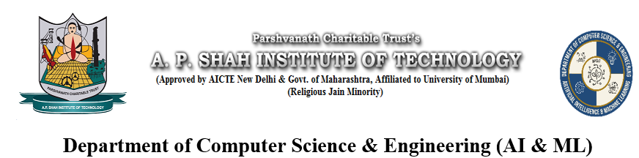
Loan Approval Prediction System
Aman Thakur(22106014)
Vaishnavi Sonawane(22106125)
Disha Suryawanshi(22106112)
Mohit Suthar(22106056)
Project Guide
Prof. Tejashree Kolhe

Slide 2
Outline
Introduction
Literature Survey of the existing systems
Limitations of the existing systems
Problem statement
System Design
Technologies and methodologies
Implementation
Conclusion
References

Slide 3
Introduction
Efficient loan approval processes are crucial in today’s fast-paced financial world.
Our prediction system enhances decision-making for banks and customers. Features two interfaces: one for banks and one for customers.
Bank Interface:
Financial entities use this interface to evaluate loan applications.
Inputs include user income, credit history, and loan amount to assess loan eligibility.
The system predicts loan approval likelihood.
Helps banks efficiently identify deserving candidates.

Slide 4
2. Customer Interface:
Clients can submit loan applications directly.
Essential information includes monthly income, marital status, desired loan amount, and duration.
Users can view interest rates and key details from various banks.
Helps identify the most suitable loan offers and terms.
Integrating these interfaces accelerates the application process and enhances transparency, ensuring deserving clients receive prompt and fair results.

Slide 5
Objectives
To simplify the loan application process to make it easier for customers and banks.
To utilize machine learning to predict the likelihood of loan repayment
To provide a user-friendly interface that allows customers to view and compare interest rates and loan offers from various banks.
To help customers make smart choices and find the best loan options that fit their needs.

Slide 6
Literature Survey
Sr. no | Title | Author | Publication Year | Conclusion
1 | Loan Approval Prediction using Machine Learning: A Comparative Analysis of Classification Algorithms | Prabaljeet Singh Sai | 2023 | Compares models like Logistic Regression, Decision Trees, Random Forests, SVM, and Neural Networks based on income and credit history.
2 | An Efficient Loan Approval Status Prediction Using Machine Learning | R Nancy Deborah | 2023 | Creates a machine learning model to enhance loan approval accuracy using credit history and income.
3 | Prediction of Modernized Loan Approval System Based on Machine Learning Approach | Singh, V. | 2021 | Proposes a machine learning model to enhance loan approvals by analyzing credit history and income for faster decisions.

Slide 7
Sr. no | Title | Author | Publication Year | Conclusion
4 | Design and Simulation of Loan Approval Prediction Model using AWS Platform | Ramachan dra | 2021 | The study shows how AWS services like SageMaker, Lambda, and S3 enhance the scalability and efficiency of loan prediction systems.
5 | Bank Loan Prediction System using Machine Learning. | Gupta | 2020 | The study analyzes credit score and income to enhance accuracy and efficiency, helping banks automate decisions and reduce errors..

Slide 8
Limitations of Existing Systems
Lack of Real-Time Data Integration: Many systems do not incorporate real-time financial data, leading to outdated or less accurate predictions.
Scalability Challenges: Many systems are not designed to scale efficiently with large volumes of data, leading to slower processing times and decreased performance.
Lack of Interpretability: Many machine learning models used for loan approval, such as deep learning models, are black boxes. This lack of interpretability makes it difficult for stakeholders to understand and trust the predictions

Slide 9
Problem Statement
Finding the right loan can be difficult for consumers due to the overwhelming options and cluttered online platforms that provide limited recommendations and excessive ads. Meanwhile, banks struggle to identify the most qualified candidates for approval, resulting in inefficiencies in their decision-making.
To tackle these challenges, we developed a loan approval prediction system with a user-friendly interface. This system uses machine learning to assess the likelihood of loan approval based on individual financial details, helping consumers find the best options.

Slide 10
At the same time, it provides banks with insights on the most suitable candidates for approval. By highlighting interest rates and loan terms, our solution made the loan process easier for both customers and banks.

Slide 11
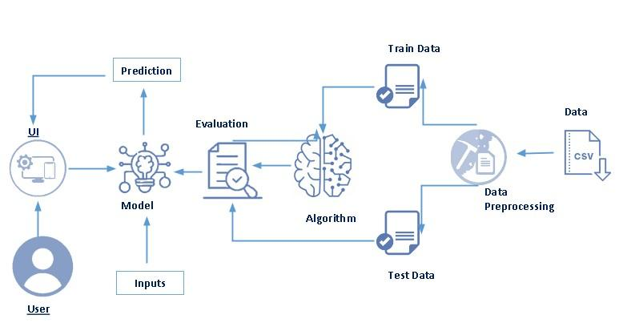
System Design

Slide 12
Data Collection: Dataset from Kaggle includes gender, marital status, income, loan details, and credit history; split into 75% training and 25% testing.
Data preprocessing: Raw data is cleaned using data mining techniques to address missing and noisy information. Ensures data is normalized and ready for model training.
Train-Test Split: A technique that divides a dataset into two parts:
Training Data: Used to train the model by learning patterns.
Test Data: Evaluates model performance on unseen data, assessing generalizability.

Slide 13
Algorithm: Predicts a customer's loan repayment ability. Focuses on Logistic Regression, which builds a predictive model using training data.
Model Selection: Choosing the best machine learning model for a loan dataset.
Key criteria: More effective than naive models, other tested models, and state-of-the-art approaches.
Focuses on Logistic Regression.
Trained model predicts loan approval status as a probability between 0 and 1.
Test data evaluates performance on unseen applicants.
Enables accurate predictions based on training patterns.

Slide 14
Evaluation:
Uses metrics like accuracy, precision, recall, and F1-score to assess performance.
Can be retrained with different algorithms or improved data if needed and achieves 91% accuracy.
Prediction: The model predicts loan approval for new applicants based on processed details.
User Interface:
A bank official inputs applicant data into the UI with eleven independent and one dependent attribute.
The UI interacts with the model to display results as approved or denied.

Slide 15
Technologies and Methodologies
Python is used for building the machine learning model, data processing, and the web interface.
Used IDEs like VS code and Jupyter Notebook for writing debugging code.
The loan approval dataset is sourced from Kaggle and data is manipulated using Pandas.
Used Streamlit for ML model deployment.
Used Flask to build the backend and integrate the ML model with the user interface.
HTML/CSS is used for registration, login, and loan application forms.

Slide 16
JavaScript is used for adding interactivity in forms or pages.
Logistic Regression: It is a classification method used to assign observations to discrete outcomes. It defines the relationship between a binary dependent variable and independent variables.

Slide 17
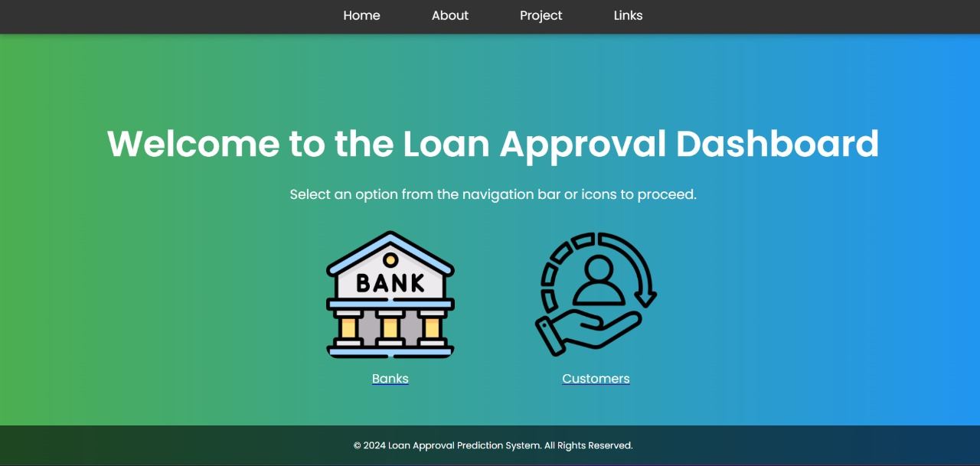
Implementation
Fig 7.1 Welcome page

Slide 18
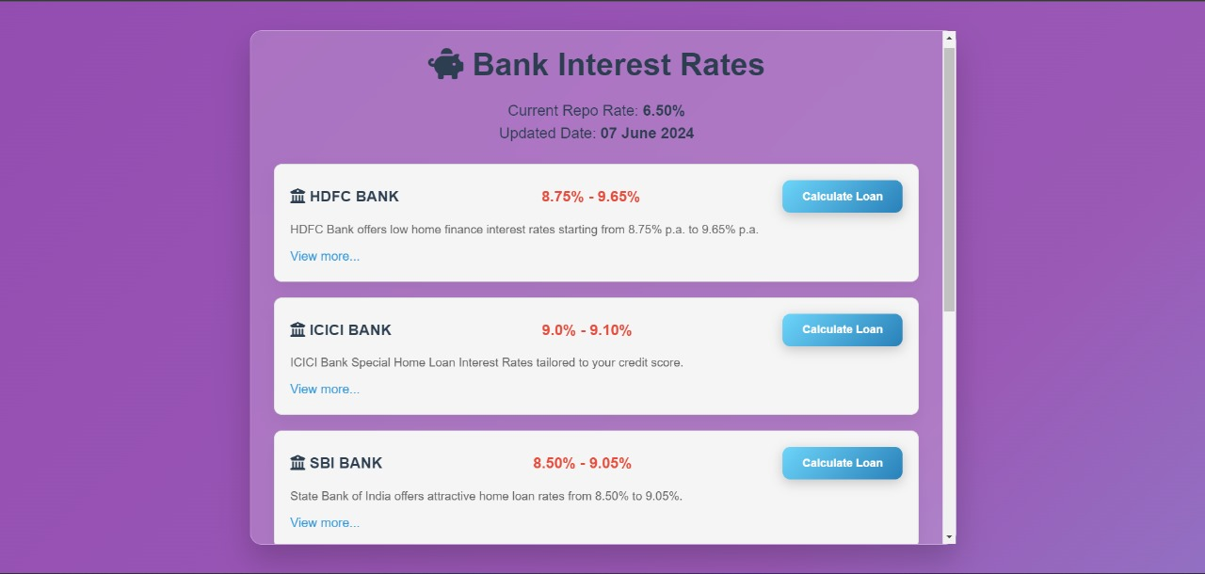
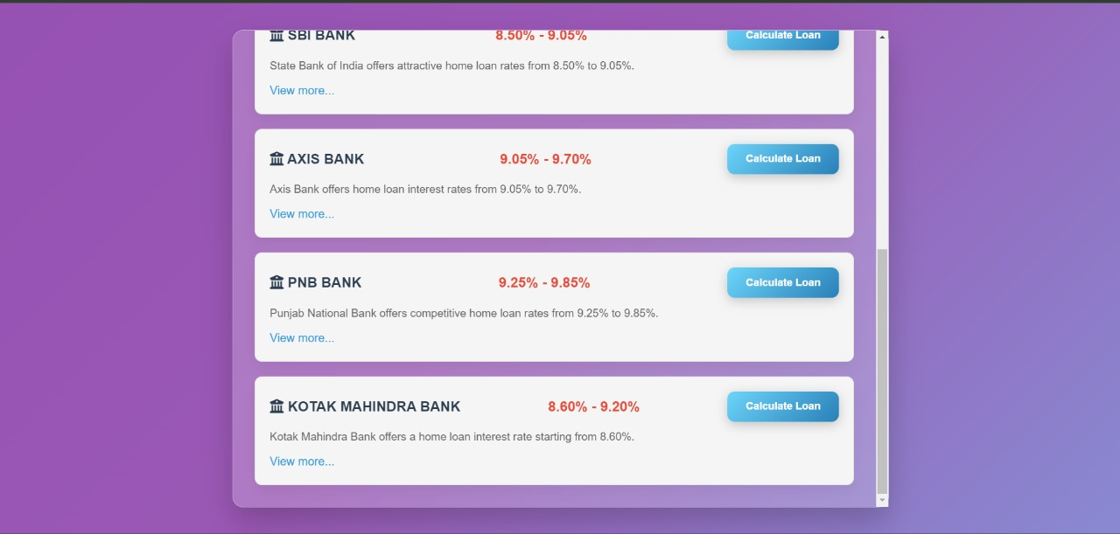
Fig 7.2 Customer Interface page
Fig 7.3 Customer Interface Page

Slide 19
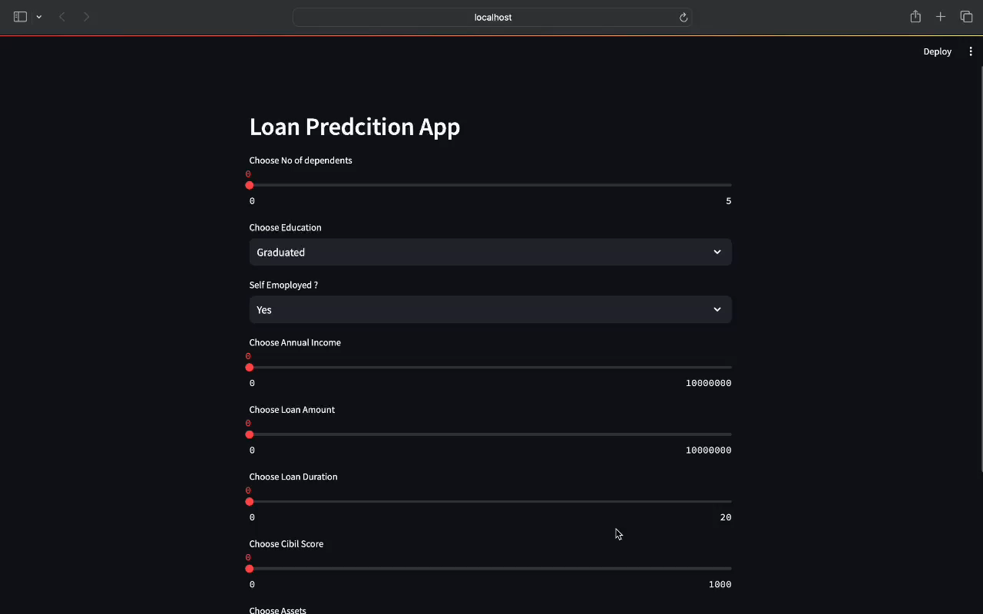
Fig 7.4 Bank Interface Page

Slide 20
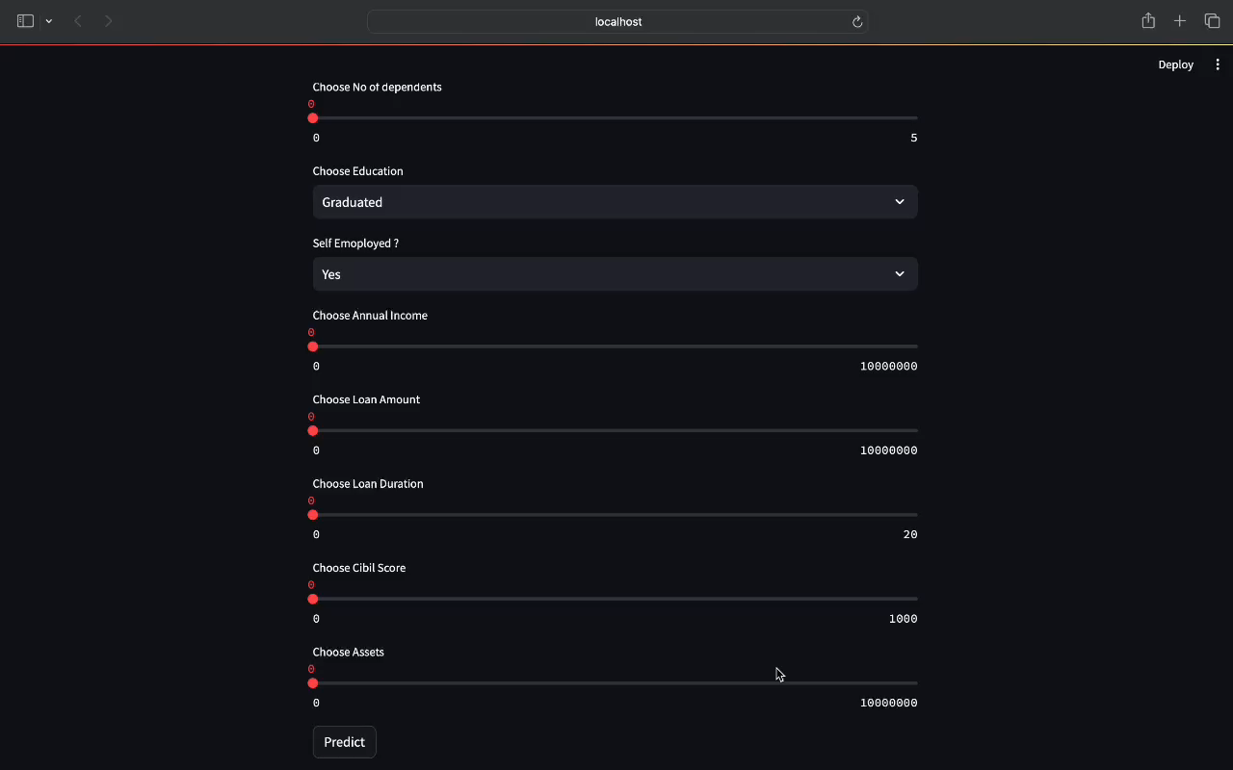
Fig 7.5 Bank Interface Page

Slide 21
Conclusion
Our Loan Approval Prediction System simplifies the loan approval process for banks and customers.
Bank Interfaces: The Bank Interface streamlines application evaluation, enabling quick assessments and faster responses to deserving applicants, enhancing customer satisfaction.
Customer Interface: The Customer Interface allows clients to manage applications and compare offers, fostering transparency and trust. Together, these interfaces ensure an efficient and fair lending experience for everyone.

Slide 22
References
[1] Prabaljeet Singh Saini, Atush Bhatnagar, Lekha Rani, “Loan Approval Prediction using Machine Learning: A Comparative Analysis of Classification Algorithms”, 2023 3rd International Conference on Advance Computing and Innovative Technologies in Engineering (ICACITE), Greater Noida, 2023, 10.1109/ICACITE57410.2023.10182799.
[2] R Nancy Deborah; S Alwyn Rajiv; A Vinora; C Manjula Devi; S Mohammed Arif; G S Mohammed Arif, “An Efficient Loan Approval Status Prediction Using Machine Learning”, 2023 International Conference on Advanced Computing Technologies and Applications (ICACTA), Mumbai, 10.1109/ICACTA58201.2023.10392691.

Slide 23
[3] Singh, V., Yadav, A., Awasthi, R., & Partheeban, G. N, “Prediction of Modernized Loan Approval System Based on Machine Learning Approach”. 2021 International Conference on Intelligent Technologies. doi:10.1109/conit51480.2021.9498475.
[4] Ramachandra, H., Balaraju, G., Divyashree, R., & Patil, H. (2021). Design and Simulation of Loan Approval Prediction Model using AWS Platform. 2021 International Conference on Emerging Smart Computing and Informatics (ESCI). doi:10.1109/esci50559.2021.9397049.
[5] Gupta, A., Pant, V., Kumar, S., & Bansal, P. K. (2020). Bank Loan Prediction System using Machine Learning. 2020 9th International Conference System Modeling and Advancement in Research Trends (SMART). doi:10.1109/smart50582.2020.9336801.

Slide 24
Thank You...!!

